Slide 1
St. Louis Central Corridor West Building Permits
Monthly Report: February 2021

Slide 2
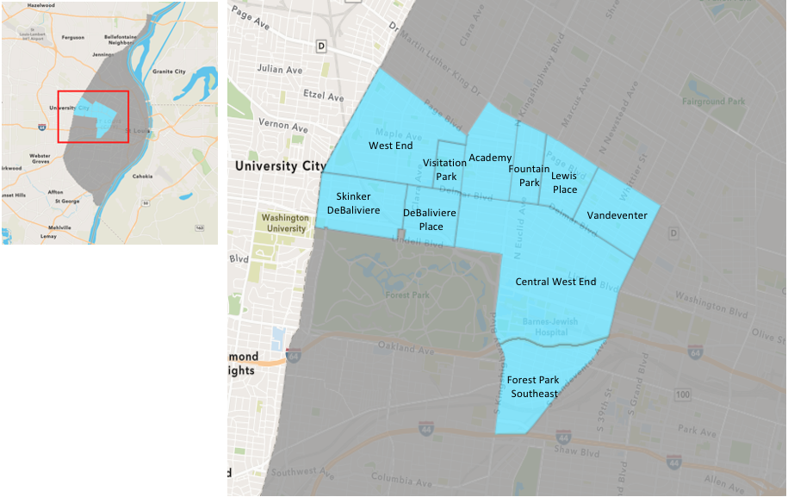
St. Louis Neighborhood Spatial Reference

Slide 3
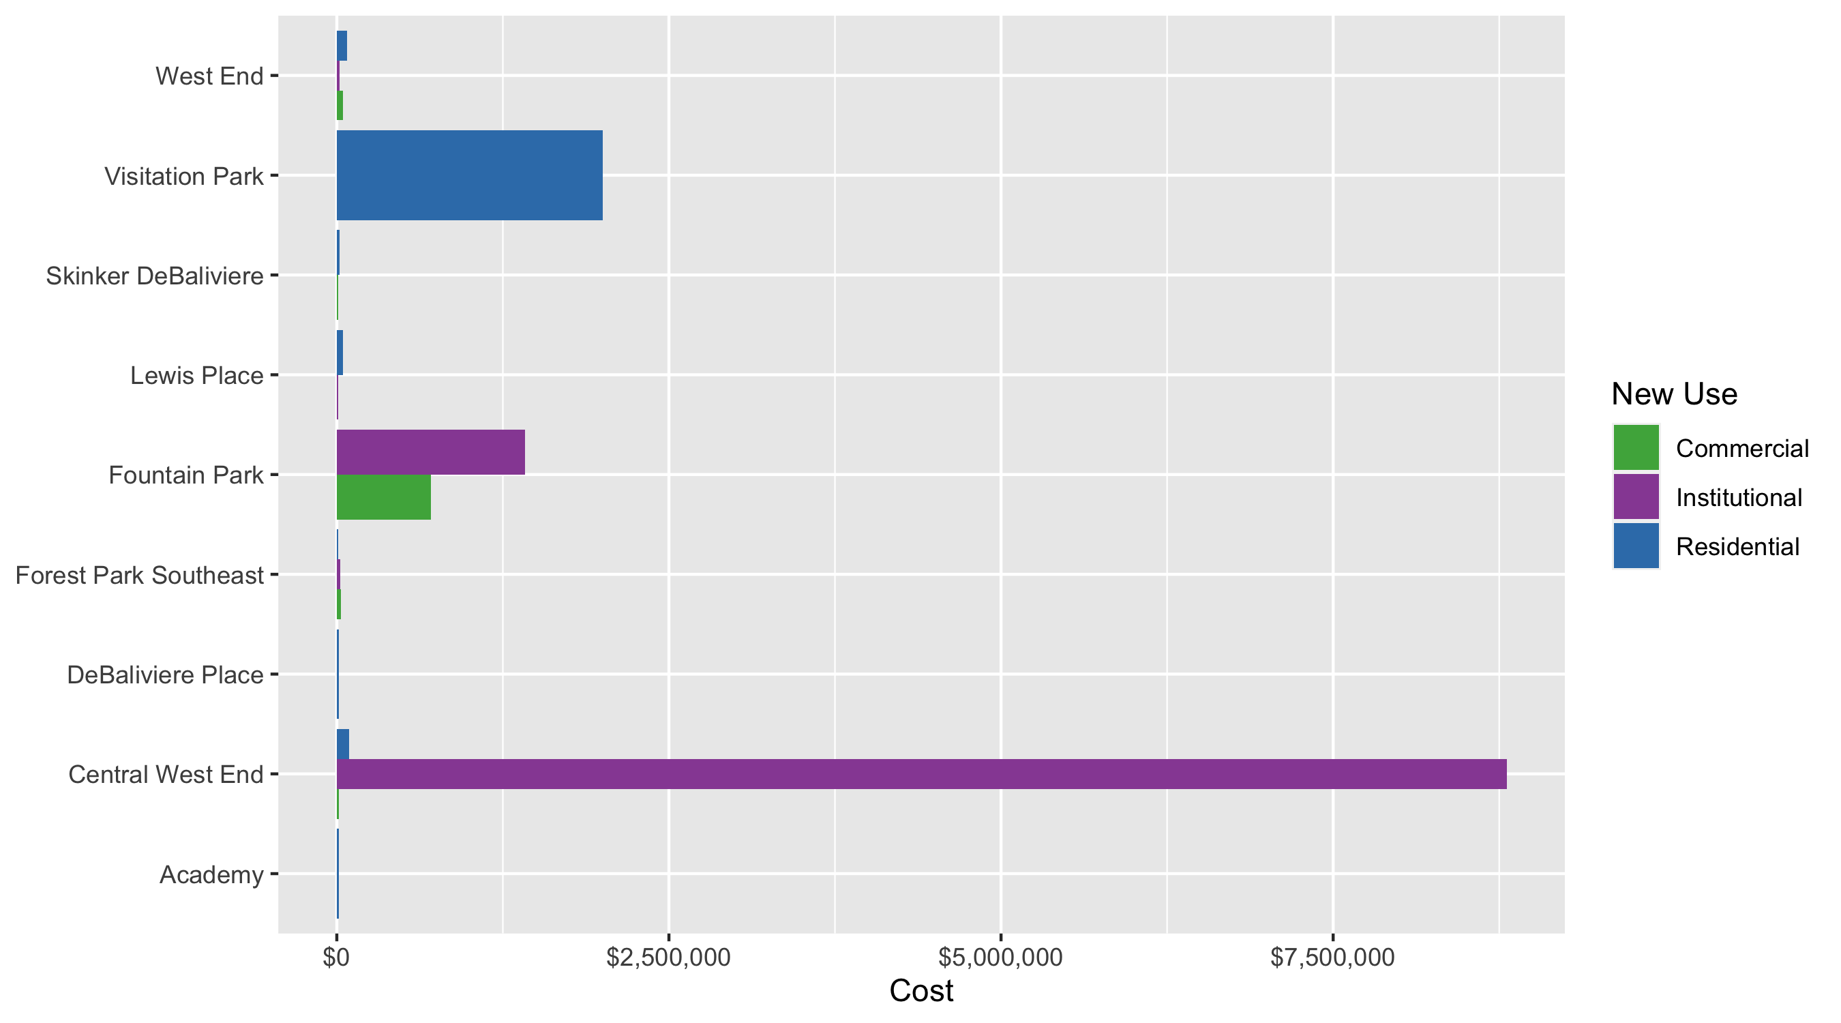
Neighborhood Summary: Average Building Permit Cost

Slide 4
Neighborhood Summary
February 2021 | February 2021 | February 2021 | February 2021
Neighborhood | Average Cost | # of Permits | Total Value of Permits
Academy | $13,900 | 1 | $13,900
Central West End | $2,991,504 | 27 | $80,770,607
DeBaliviere Place | $15,617 | 3 | $46,850
Forest Park Southeast | $19,167 | 6 | $115,000
Fountain Park | $1,182,449 | 3 | $3,547,348
Lewis Place | $27,500 | 2 | $55,000
Skinker DeBaliviere | $17,647 | 7 | $123,527
Vandeventer | $0 | 0 | $0
Visitation Park | $2,000,000 | 1 | $2,000,000
West End | $68,892 | 12 | $826,698
Last 6 Months | Last 6 Months | Last 6 Months | Last 6 Months
Neighborhood | Average Cost | # of Permits | Total Value of Permits
Academy | $21,372 | 20 | $427,444
Central West End | $869,956 | 189 | $164,421,773
DeBaliviere Place | $443,787 | 27 | $11,982,258
Forest Park Southeast | $820,996 | 72 | $59,111,718
Fountain Park | $750,470 | 5 | $3,752,348
Lewis Place | $20,397 | 14 | $285,563
Skinker DeBaliviere | $56,417 | 59 | $3,328,601
Vandeventer | $21,496 | 8 | $171,972
Visitation Park | $504,168 | 4 | $2,016,674
West End | $72,792 | 55 | $4,003,570

Slide 5
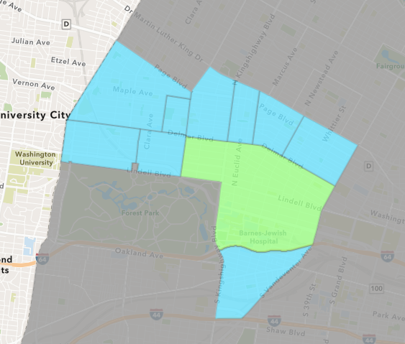
Central West End
February 2021 Neighborhood Cost Breakdown
Mean: $2,991,504
Median: $25,000
Range: $50 - $78,300,000

Slide 6
Central West End: Summary Notes
27 building permits in February 2021
-12.90% change compared to February 2020 (31 total building permits)
$2,991,504: Average building permit cost in February 2021
5516.98% change compared to February 2020 ($53,258)
54 total building permits in 2021
-18.18% change YTD compared to this time in 2020 (66 total building permits)
$2,133,868: YTD average building permit cost in 2021
639.21% change YTD compared to this time in 2020 ($288,669)

Slide 7
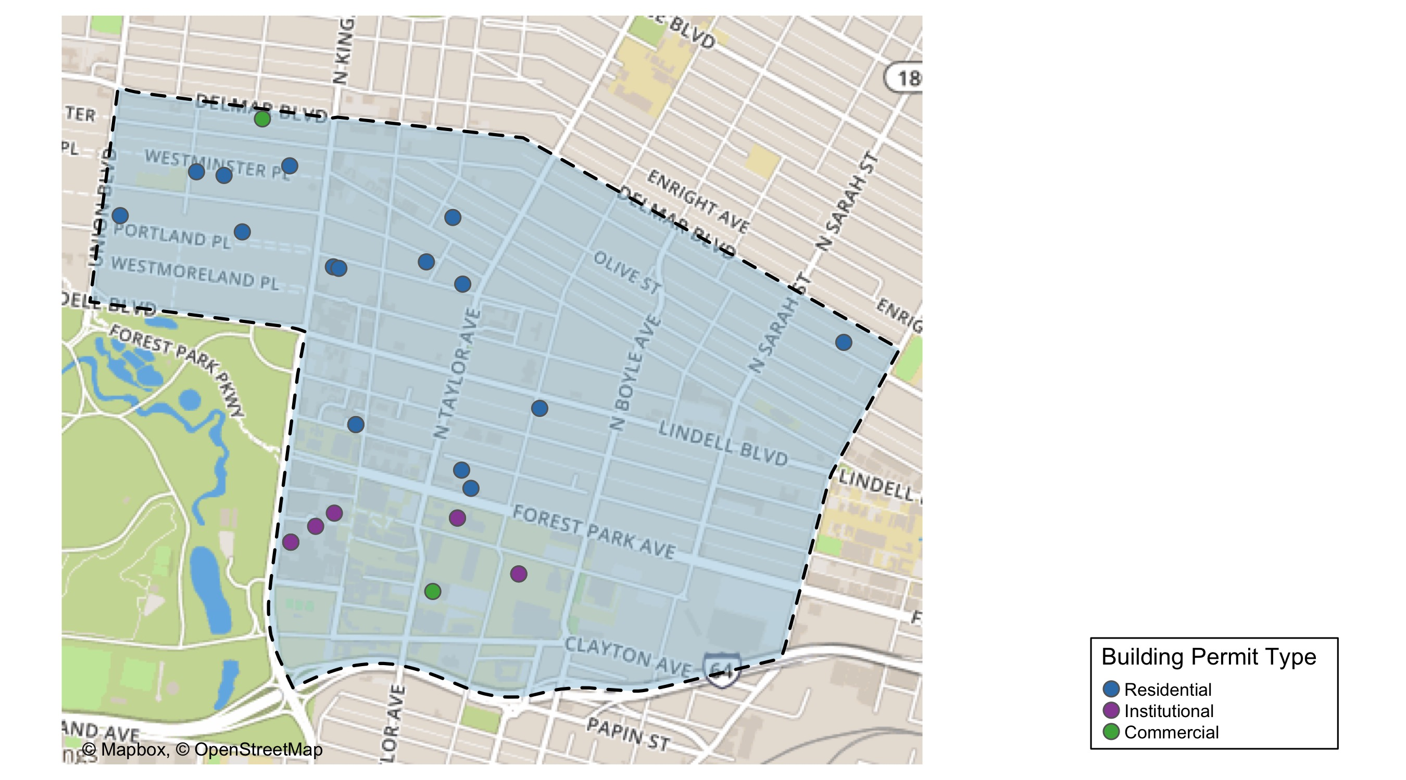
Central West End

Slide 8
Neighborhood Summary
February 2021 | February 2021 | February 2021 | February 2021
Permit Use | Average Cost | # of Permits | Total Value of Permits
Commercial | $15,000 | 2 | $30,000
Industrial | $0 | 0 | $0
Institutional | $8,805,967 | 9 | $79,253,702
Residential | $92,932 | 16 | $1,486,905
Last 6 Months | Last 6 Months | Last 6 Months | Last 6 Months
Permit Use | Average Cost | # of Permits | Total Value of Permits
Commercial | $1,089,351 | 32 | $34,859,233
Industrial | $0 | 0 | $0
Institutional | $1,590,384 | 56 | $89,061,531
Residential | $401,000 | 101 | $40,501,009

Slide 9
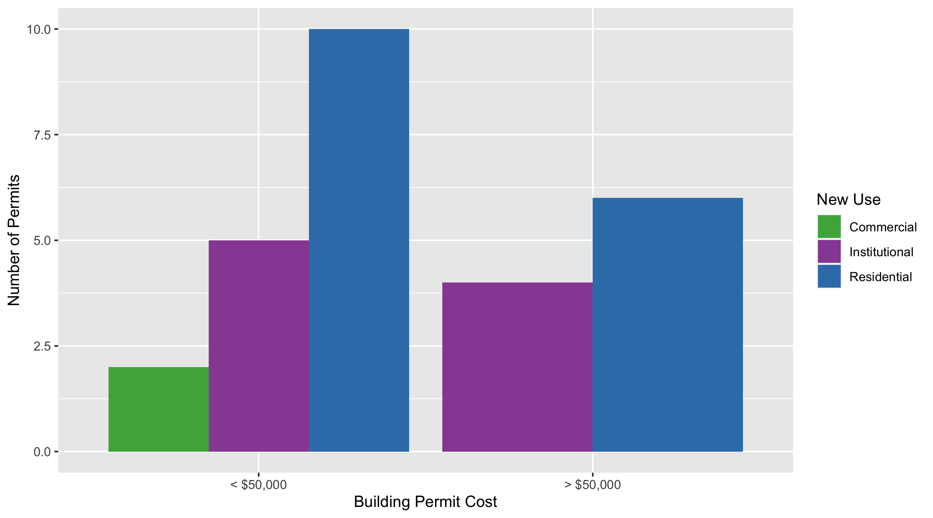
Central West End Permit Cost Breakdown

Slide 10
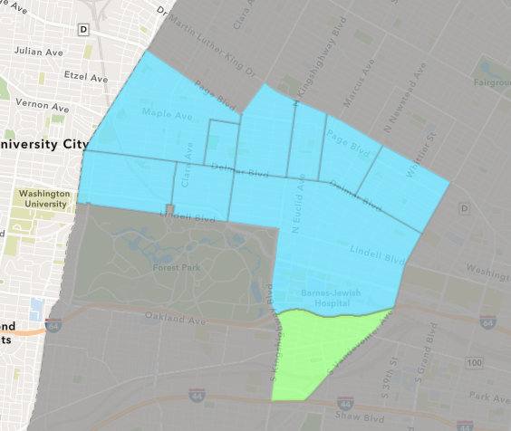
Forest Park Southeast
February 2021 Neighborhood Cost Breakdown
Mean: $19,167
Median: $18,000
Range: $1,000 - $40,000

Slide 11
Forest Park Southeast: Summary Notes
6 building permits in February 2021
20.00% change compared to February 2020 (5 total building permits)
$19,167: Average building permit cost in February 2021
-74.39% change compared to February 2020 ($74,830)
25 total building permits in 2021
78.57% change YTD compared to this time in 2020 (14 total building permits)
$95,353: YTD average building permit cost in 2021
45.06% change YTD compared to this time in 2020 ($65,735)

Slide 12
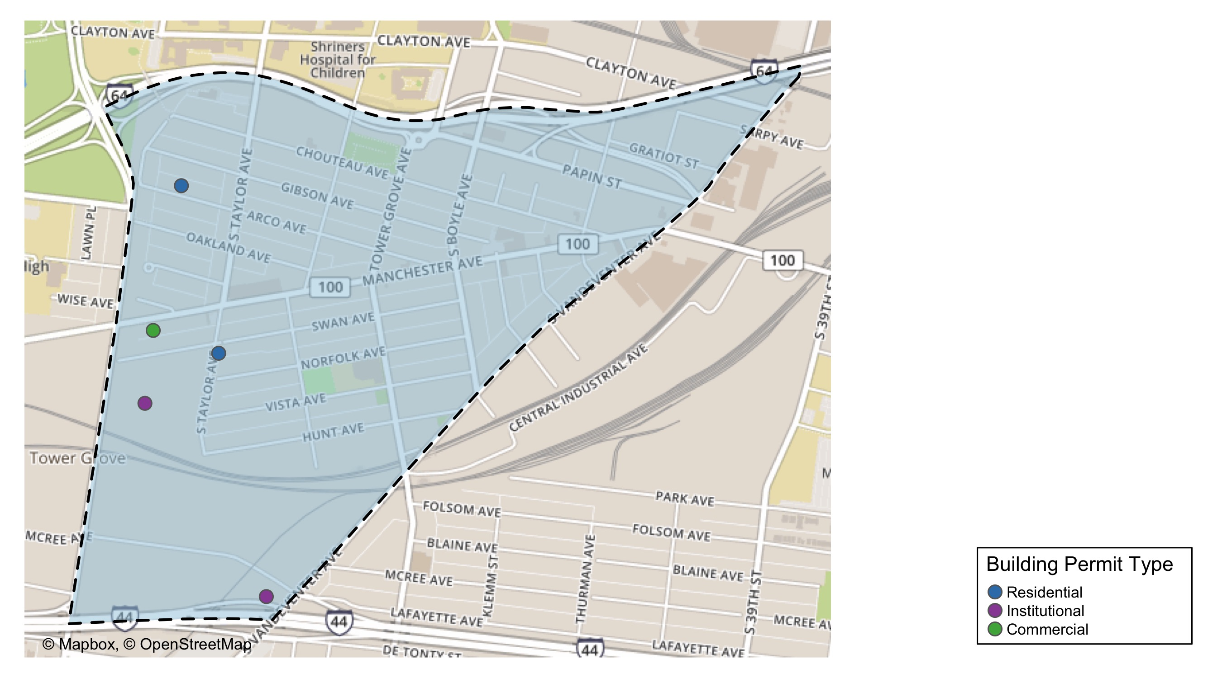
Forest Park Southeast

Slide 13
Neighborhood Summary
February 2021 | February 2021 | February 2021 | February 2021
Permit Use | Average Cost | # of Permits | Total Value of Permits
Commercial | $30,000 | 1 | $30,000
Industrial | $0 | 0 | $0
Institutional | $24,000 | 2 | $48,000
Residential | $12,333 | 3 | $37,000
Last 6 Months | Last 6 Months | Last 6 Months | Last 6 Months
Permit Use | Average Cost | # of Permits | Total Value of Permits
Commercial | $24,136 | 13 | $313,771
Industrial | $6,100 | 1 | $6,100
Institutional | $517,232 | 11 | $5,689,552
Residential | $1,129,836 | 47 | $53,102,295

Slide 14
Forest Park Southeast Individual Permit Breakdown
Owner | New Use | Cost | address
WINTER HOLDINGS LLC | Commercial | $30,000 | 4568 MANCHESTER AV
PACECO LLC | Institutional | $40,000 | 1641 S VANDEVENTER AV
DRESSELHAUS, JOEL | Residential | $1,000 | 4551 ARCO AV
WASHINGTON UNIVERSITY | Institutional | $8,000 | 1234 S KINGSHIGHWAY BLVD
BENTRUP, SCOTT M | Residential | $16,000 | 4466 SWAN AV
PWI LLC | Residential | $20,000 | 4388-90 CHOUTEAU AV

Slide 15
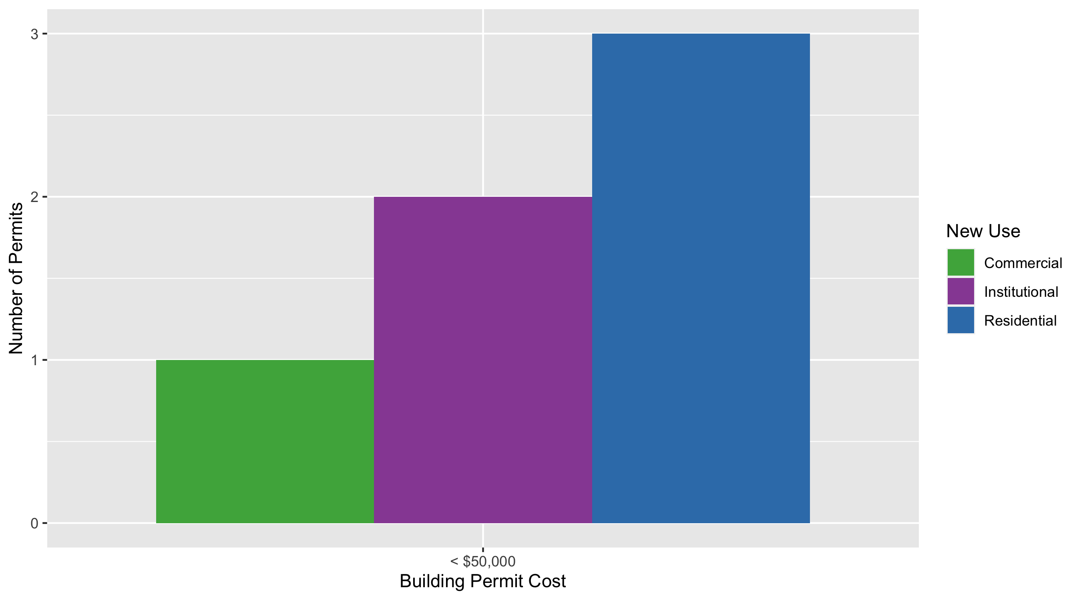
Forest Park Southeast Permit Cost Breakdown

Slide 16
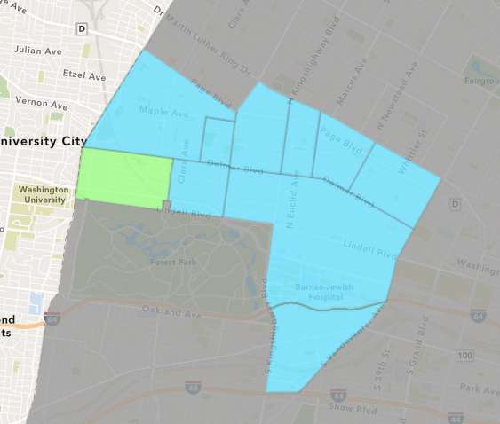
Skinker DeBaliviere
February 2021 Neighborhood Cost Breakdown
Mean: $17,647
Median: $13,352
Range: $2,500 - $59,399

Slide 17
Skinker DeBaliviere: Summary Notes
7 building permits in February 2021
-63.16% change compared to February 2020 (19 total building permits)
$17,647: Average building permit cost in February 2021
8.24% change compared to February 2020 ($16,303)
20 total building permits in 2021
-23.08% change YTD compared to this time in 2020 (26 total building permits)
$34,561: YTD average building permit cost in 2021
78.73% change YTD compared to this time in 2020 ($19,337)

Slide 18
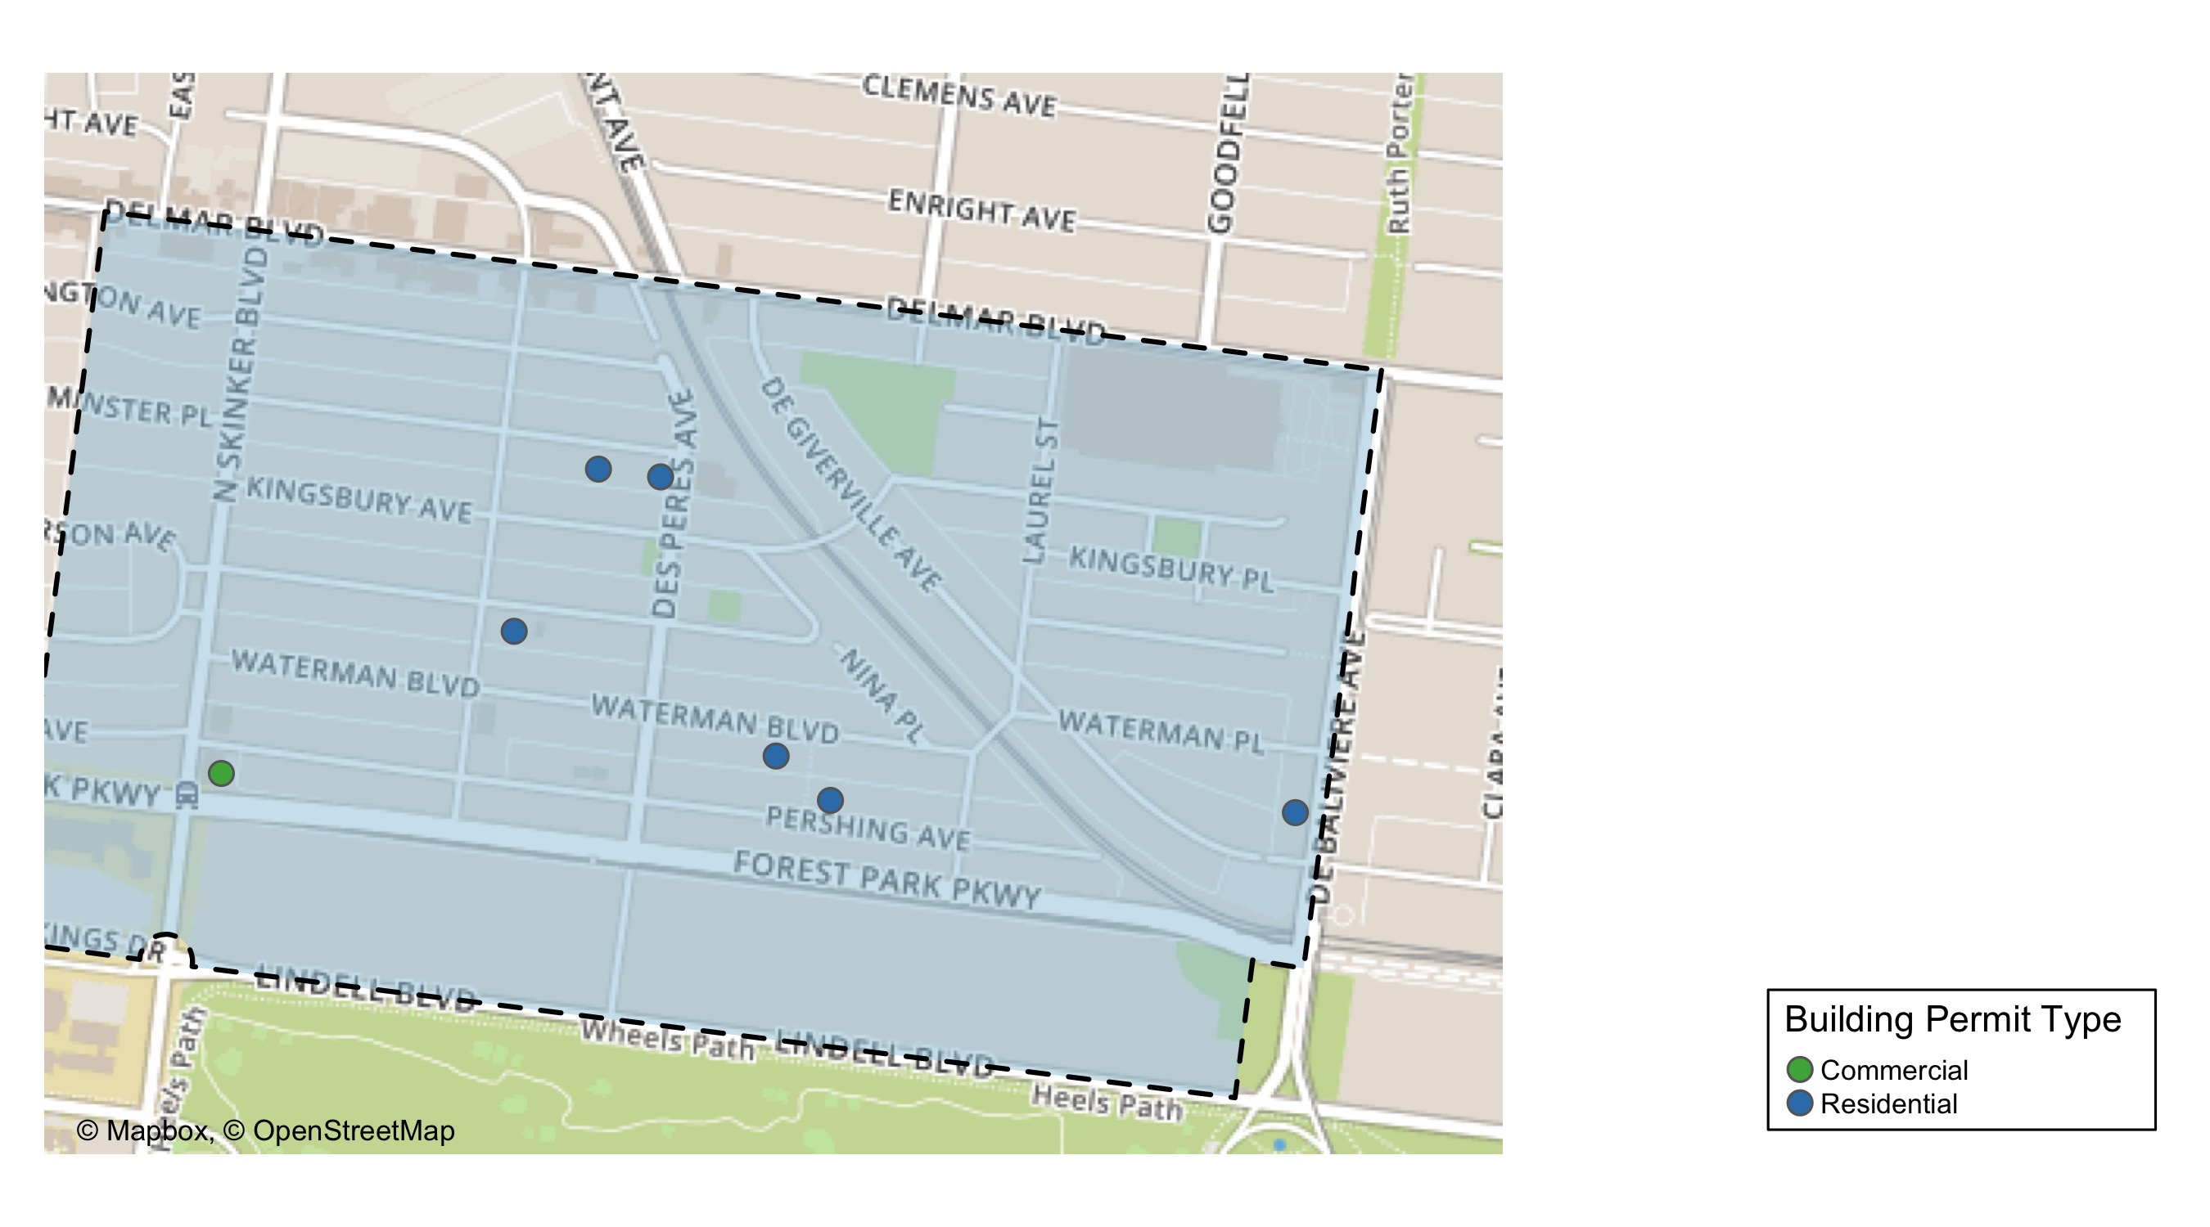
Skinker DeBaliviere

Slide 19
Neighborhood Summary
February 2021 | February 2021 | February 2021 | February 2021
Permit Use | Average Cost | # of Permits | Total Value of Permits
Commercial | $8,500 | 1 | $8,500
Industrial | $0 | 0 | $0
Institutional | $0 | 0 | $0
Residential | $19,171 | 6 | $115,027
Last 6 Months | Last 6 Months | Last 6 Months | Last 6 Months
Permit Use | Average Cost | # of Permits | Total Value of Permits
Commercial | $88,060 | 5 | $440,300
Industrial | $0 | 0 | $0
Institutional | $253,470 | 5 | $1,267,349
Residential | $33,081 | 49 | $1,620,952

Slide 20
Skinker DeBaliviere Individual Permit Breakdown
Owner | New Use | Cost | address
DAVIDSON, LEONTINE G | Residential | $15,604 | 6054 MCPHERSON AV
HARSLEY, RACHEL E | Residential | $2,500 | 6006 WESTMINSTER PL
HATCH, JAMES D & JANET H TRS | Residential | $15,000 | 6030 WESTMINSTER PL
RUTLIN, KYLE S & ROBIN I | Residential | $9,172 | 5851 PERSHING AV
MAR, DAVID | Residential | $13,352 | 5914 WATERMAN BLVD
DEBALIVIERE COMMUNITY CTR LP | Residential | $59,399 | 311 DEBALIVIERE AV
WASHINGTON UNIVERSITY P | Commercial | $8,500 | 282 N SKINKER BLVD

Slide 21
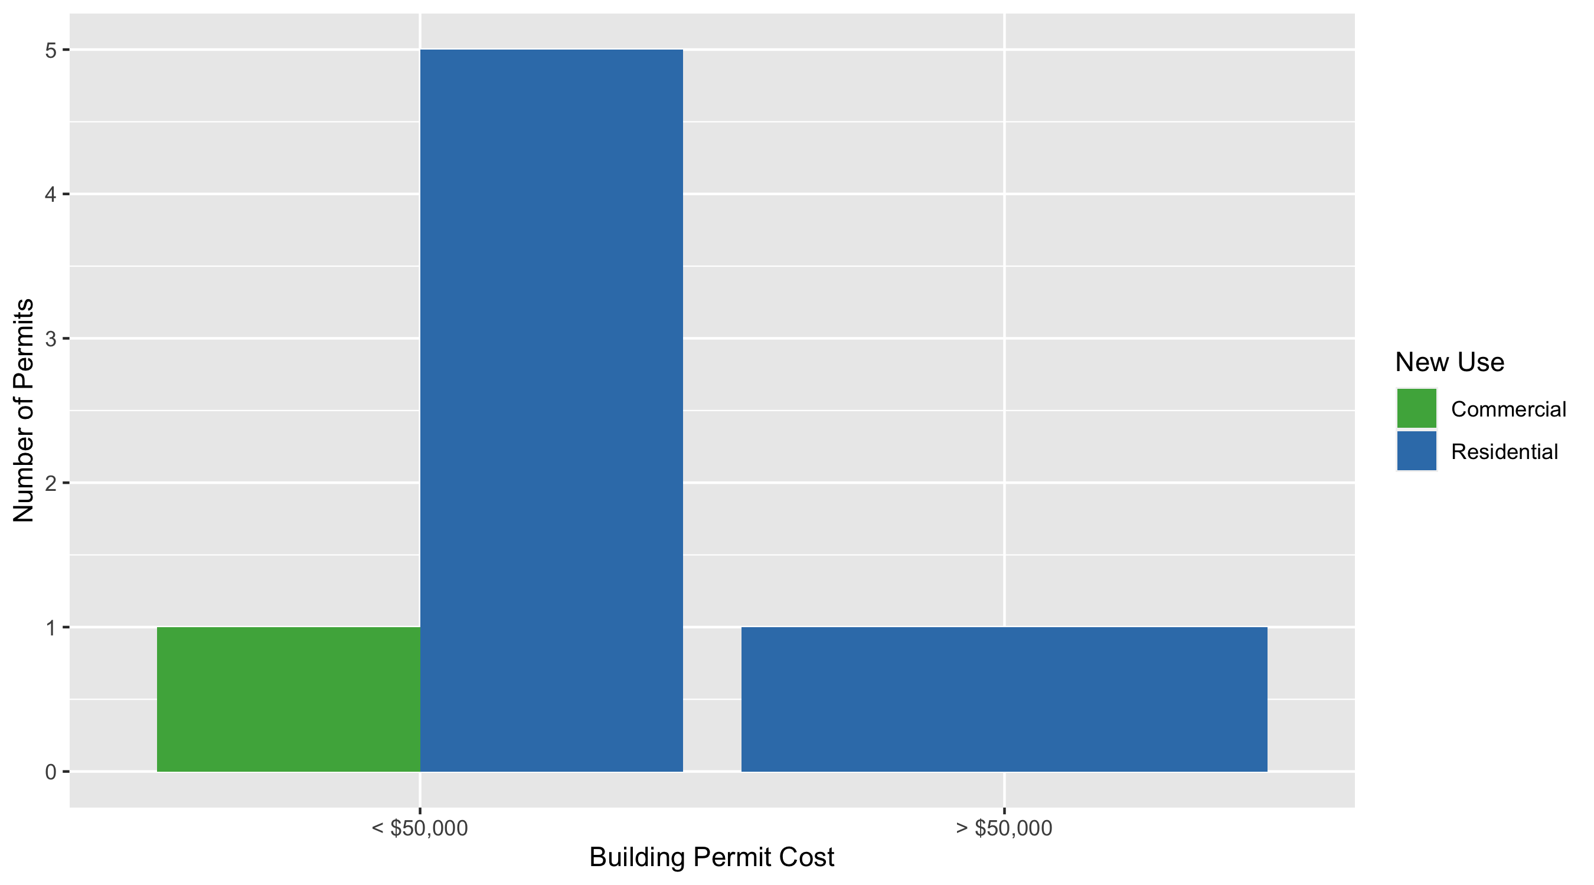
Skinker DeBaliviere Permit Cost Breakdown

Slide 22
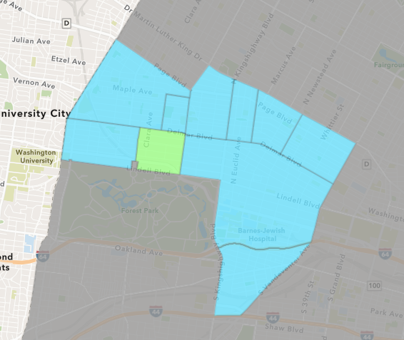
DeBaliviere Place
February 2021 Neighborhood Cost Breakdown
Mean: $15,617
Median: $12,350
Range: $4,500 - $30,000

Slide 23
DeBaliviere Place: Summary Notes
3 building permits in February 2021
Infinite change compared to February 2020 (0 total building permits)
$15,617: Average building permit cost in February 2021
Infinite change compared to February 2020 ($0)
6 total building permits in 2021
50.00% change YTD compared to this time in 2020 (4 total building permits)
$23,676: YTD average building permit cost in 2021
-99.48% change YTD compared to this time in 2020 ($4,512,000)

Slide 24
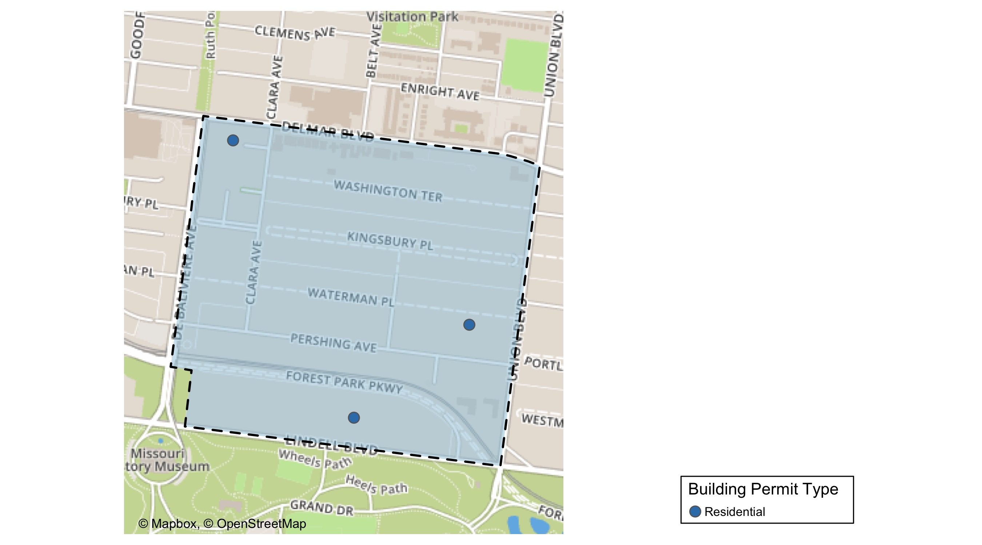
DeBaliviere Place

Slide 25
Neighborhood Summary
February 2021 | February 2021 | February 2021 | February 2021
Permit Use | Average Cost | # of Permits | Total Value of Permits
Commercial | $0 | 0 | $0
Industrial | $0 | 0 | $0
Institutional | $0 | 0 | $0
Residential | $15,617 | 3 | $46,850
Last 6 Months | Last 6 Months | Last 6 Months | Last 6 Months
Permit Use | Average Cost | # of Permits | Total Value of Permits
Commercial | $15,000 | 1 | $15,000
Industrial | $0 | 0 | $0
Institutional | $0 | 0 | $0
Residential | $460,279 | 26 | $11,967,258

Slide 26
DeBaliviere Place Individual Permit Breakdown
Owner | New Use | Cost | address
KNESE, LEONARD H & SUSANNE J | Residential | $30,000 | 5505 LINDELL BLVD
DEL MONTE APARTMENTS LLC | Residential | $4,500 | 5622 DELMAR BLVD
TIMMERMAN, JOHN CARL & HAE KYUNG | Residential | $12,350 | 40 WATERMAN PL

Slide 27
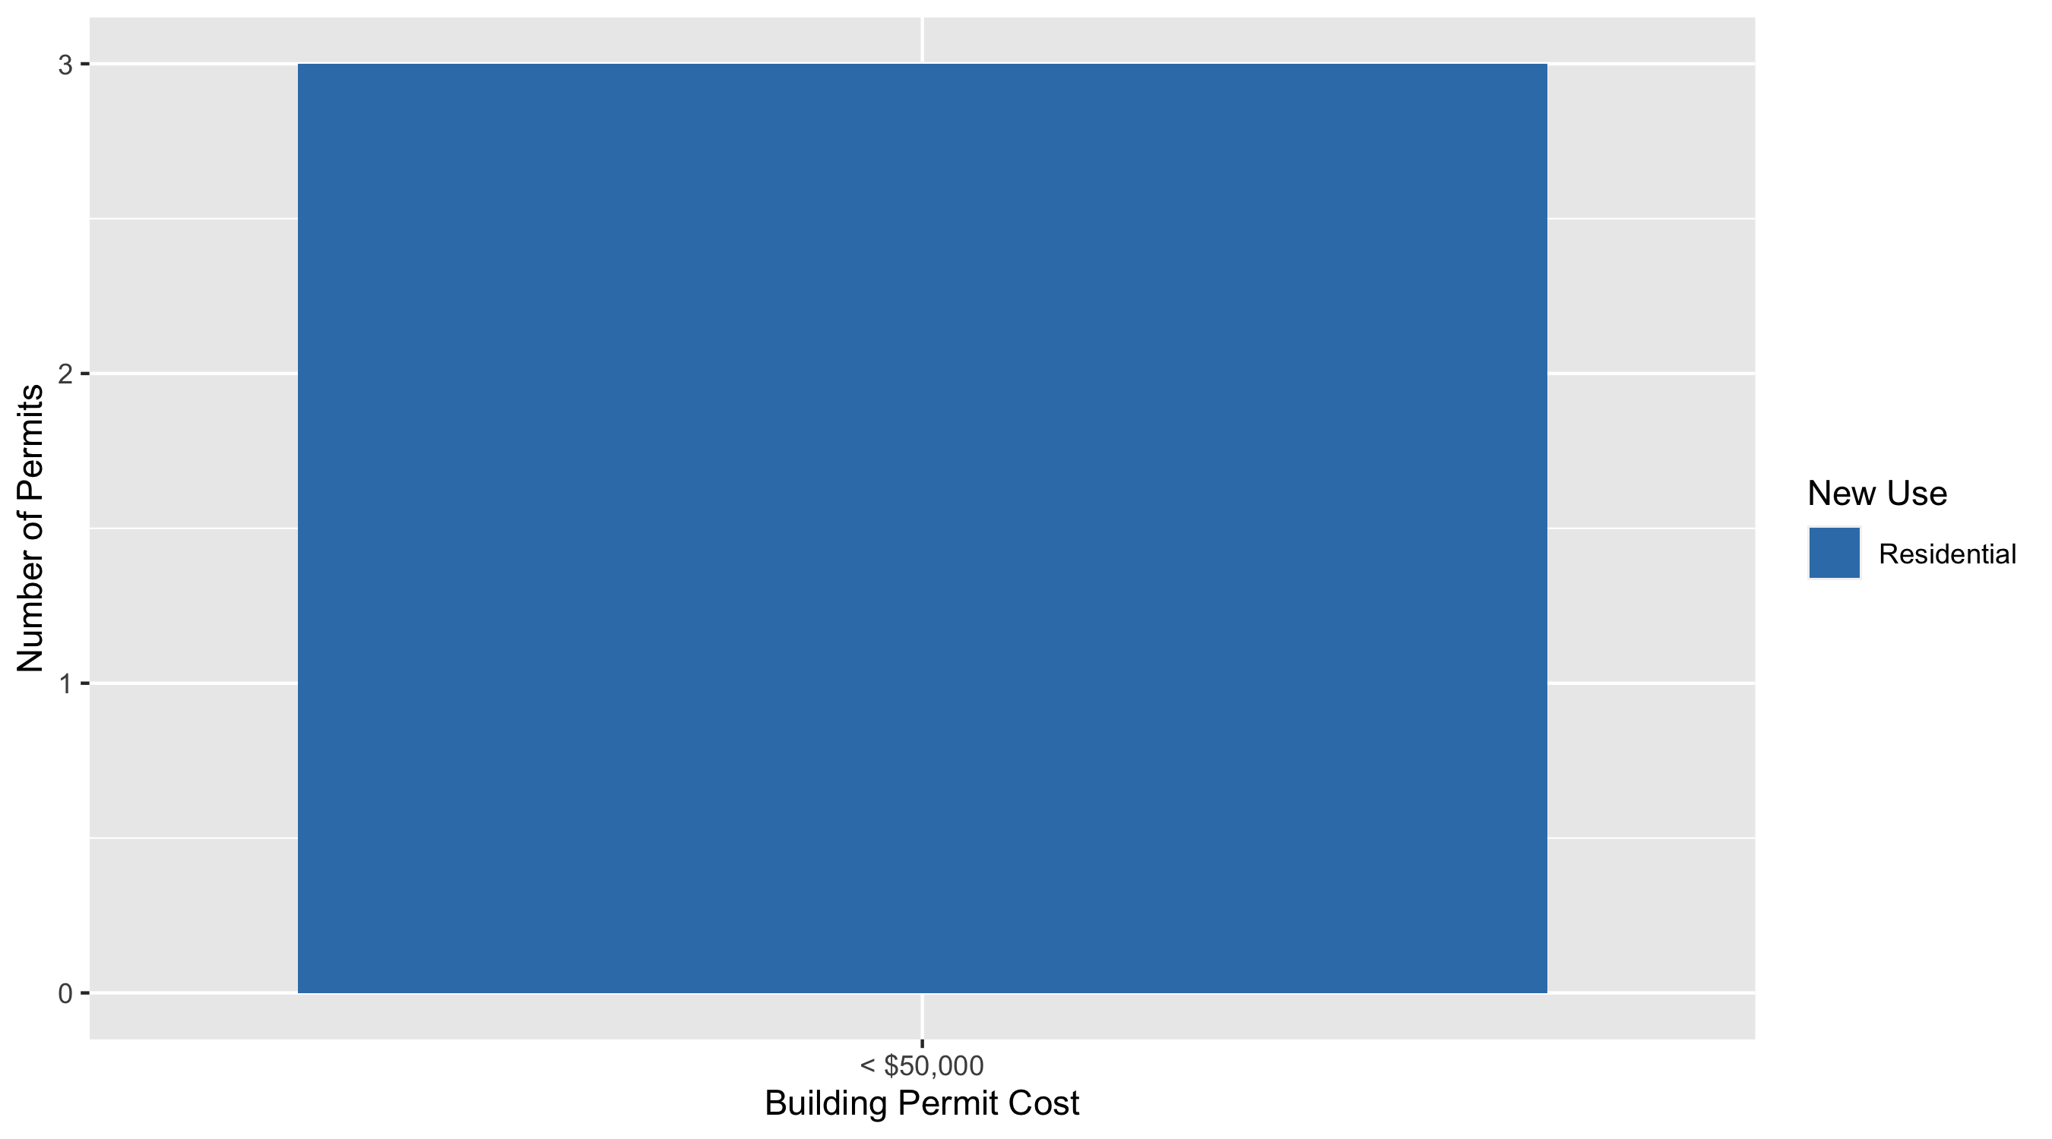
DeBaliviere Place Permit Cost Breakdown

Slide 28
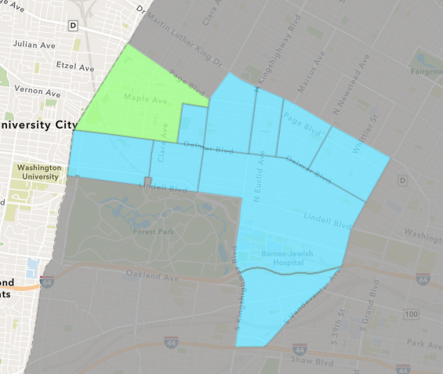
West End
February 2021 Neighborhood Cost Breakdown
Mean: $68,892
Median: $64,116
Range: $6,260 - $192,500

Slide 29
West End: Summary Notes
12 building permits in February 2021
71.43% change compared to February 2020 (7 total building permits)
$68,892: Average building permit cost in February 2021
57.26% change compared to February 2020 ($43,807)
19 total building permits in 2021
11.76% change YTD compared to this time in 2020 (17 total building permits)
$80,835: YTD average building permit cost in 2021
255.41% change YTD compared to this time in 2020 ($22,744)

Slide 30
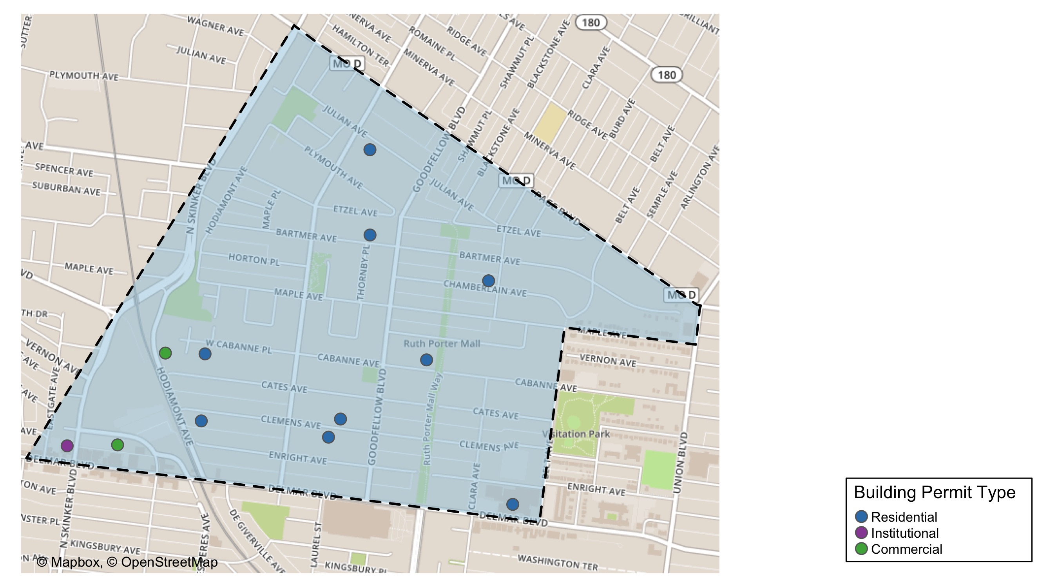
West End

Slide 31
Neighborhood Summary
February 2021 | February 2021 | February 2021 | February 2021
Permit Use | Average Cost | # of Permits | Total Value of Permits
Commercial | $46,616 | 2 | $93,232
Industrial | $0 | 0 | $0
Institutional | $20,706 | 1 | $20,706
Residential | $79,196 | 9 | $712,760
Last 6 Months | Last 6 Months | Last 6 Months | Last 6 Months
Permit Use | Average Cost | # of Permits | Total Value of Permits
Commercial | $32,316 | 10 | $323,162
Industrial | $0 | 0 | $0
Institutional | $20,706 | 1 | $20,706
Residential | $83,175 | 44 | $3,659,702

Slide 32
West End Individual Permit Breakdown
Owner | New Use | Cost | address
WILLIAMS, LUCRETIA | Residential | $10,000 | 5872 JULIAN AV
NGUYEN, DOUG | Residential | $100,000 | 5843 CLEMENS AV
TRELAWNEY PROPERTIES LLC | Commercial | $68,232 | 876 HODIAMONT AV
LIVING CLEAR REALTY LLC | Residential | $40,000 | 5609 CHAMBERLAIN AV
METIS CAPITAL LLC | Residential | $89,000 | 5831 BARTMER AV
PAGEANT BUILDING LLC | Commercial | $25,000 | 6100 ENRIGHT AV
LARRY CHAPMAN | Residential | $105,000 | 5535 DELMAR BLVD
TOLIVER, SHADRICK R & LAURA | Residential | $6,260 | 6032 CLEMENS AV
PACE-DELMAR ASSOCIATES LLC | Institutional | $20,706 | 621 N SKINKER BLVD
WEST END LLC | Residential | $192,500 | 5852 CLEMENS AV
LRA | Residential | $110,000 | 5679 CABANNE AV
BECKEMEYER, BRETT & | Residential | $60,000 | 6040 WEST CABANNE PL

Slide 33
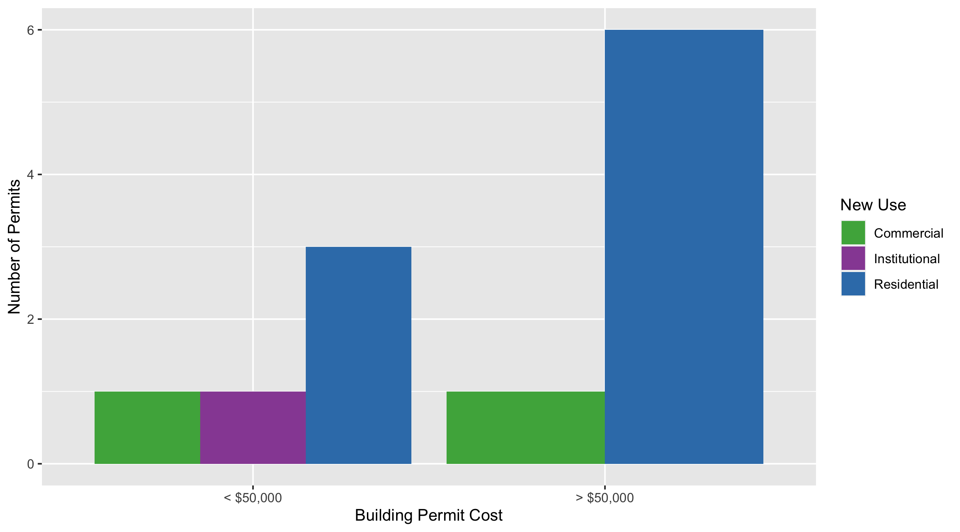
West End Permit Cost Breakdown

Slide 34
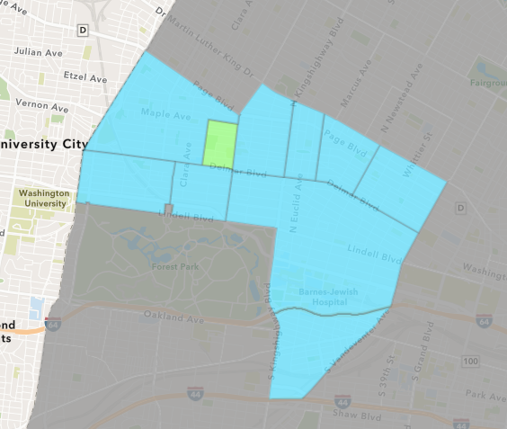
Visitation Park
February 2021 Neighborhood Cost Breakdown
Mean: $2,000,000
Median: $2,000,000
Range: $2,000,000 - $2,000,000

Slide 35
Visitation Park: Summary Notes
1 building permits in February 2021
0.00% change compared to February 2020 (1 total building permits)
$2,000,000: Average building permit cost in February 2021
14185.71% change compared to February 2020 ($14,000)
1 total building permits in 2021
0.00% change YTD compared to this time in 2020 (1 total building permits)
$2,000,000: YTD average building permit cost in 2021
14185.71% change YTD compared to this time in 2020 ($14,000)

Slide 36
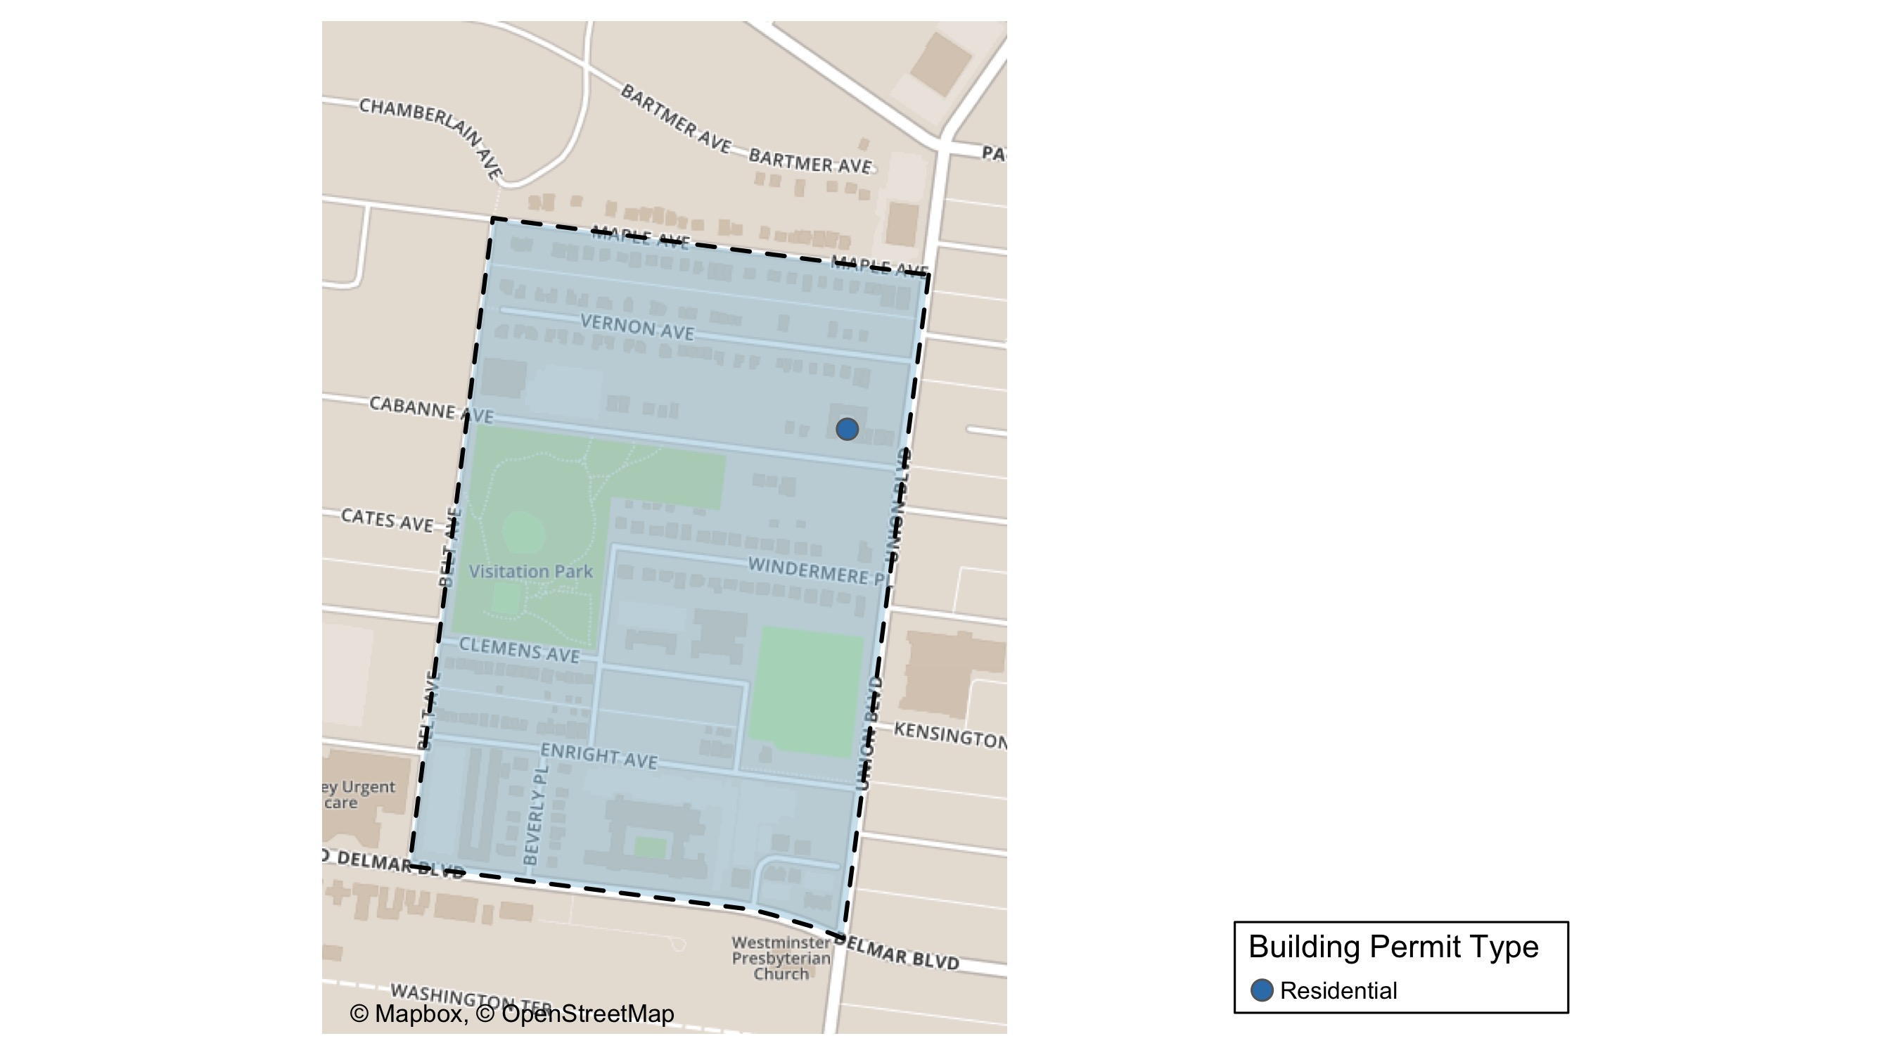
Visitation Park

Slide 37
Neighborhood Summary
February 2021 | February 2021 | February 2021 | February 2021
Permit Use | Average Cost | # of Permits | Total Value of Permits
Commercial | $0 | 0 | $0
Industrial | $0 | 0 | $0
Institutional | $0 | 0 | $0
Residential | $2,000,000 | 1 | $2,000,000
Last 6 Months | Last 6 Months | Last 6 Months | Last 6 Months
Permit Use | Average Cost | # of Permits | Total Value of Permits
Commercial | $0 | 0 | $0
Industrial | $0 | 0 | $0
Institutional | $0 | 0 | $0
Residential | $504,168 | 4 | $2,016,674

Slide 38
Visitation Park Individual Permit Breakdown
Owner | New Use | Cost | address
NEIGHBORHOOD PREPERTIES LLC | Residential | $2,000,000 | 5315 CABANNE AV

Slide 39
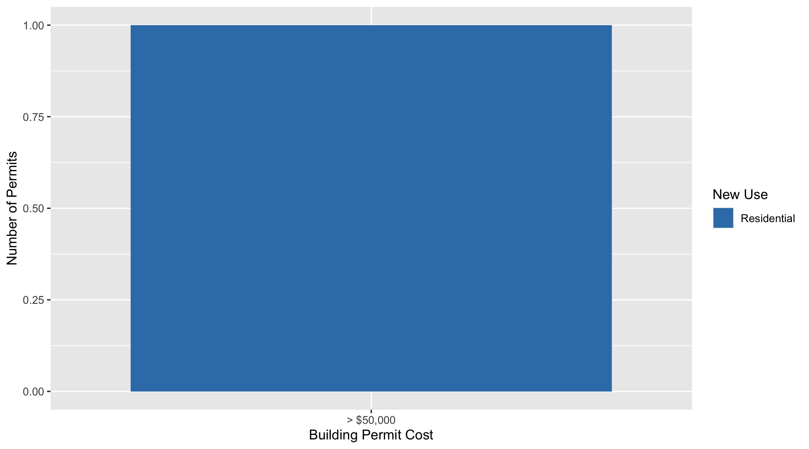
Visitation Park Permit Cost Breakdown

Slide 40
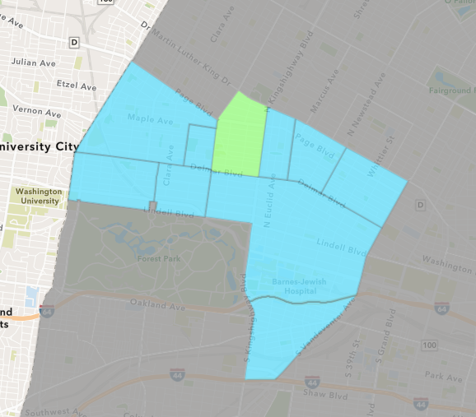
Academy
February 2021 Neighborhood Cost Breakdown
Mean: $13,900
Median: $13,900
Range: $13,900 - $13,900

Slide 41
Academy: Summary Notes
1 building permits in February 2021
-66.67% change compared to February 2020 (3 total building permits)
$13,900: Average building permit cost in February 2021
-84.84% change compared to February 2020 ($91,667)
2 total building permits in 2021
-77.78% change YTD compared to this time in 2020 (9 total building permits)
$9,188: YTD average building permit cost in 2021
-89.53% change YTD compared to this time in 2020 ($87,772)

Slide 42
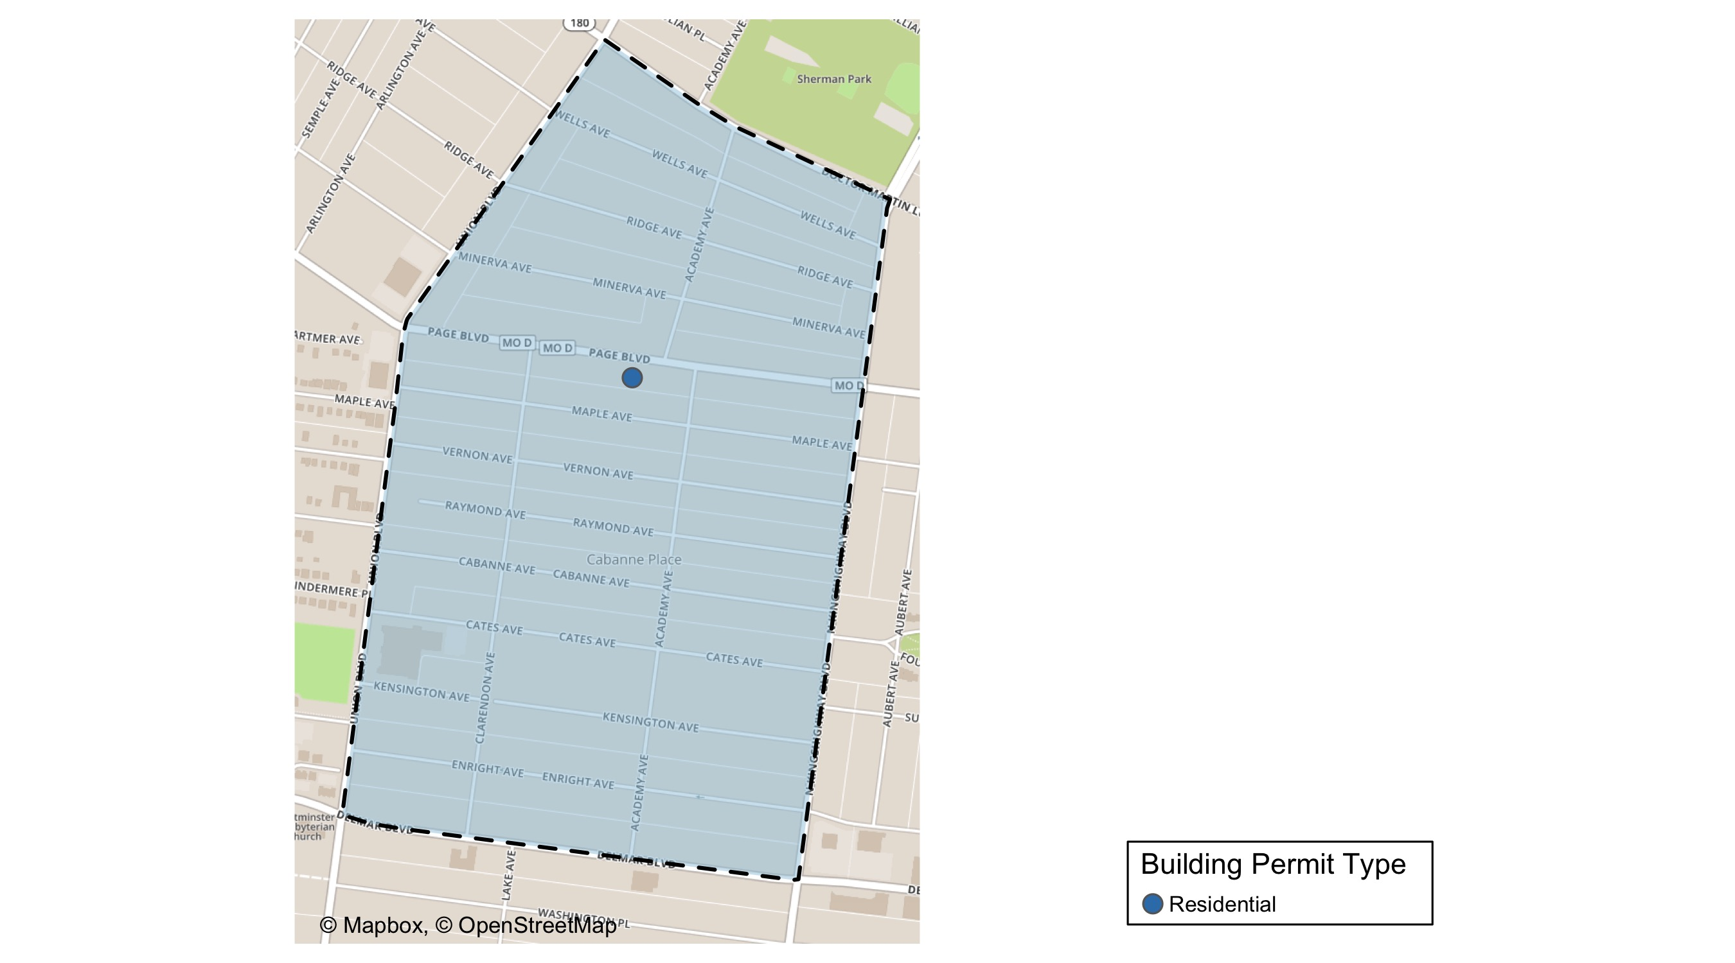
Academy

Slide 43
Neighborhood Summary
February 2021 | February 2021 | February 2021 | February 2021
Permit Use | Average Cost | # of Permits | Total Value of Permits
Commercial | $0 | 0 | $0
Industrial | $0 | 0 | $0
Institutional | $0 | 0 | $0
Residential | $13,900 | 1 | $13,900
Last 6 Months | Last 6 Months | Last 6 Months | Last 6 Months
Permit Use | Average Cost | # of Permits | Total Value of Permits
Commercial | $15,000 | 1 | $15,000
Industrial | $0 | 0 | $0
Institutional | $5,500 | 1 | $5,500
Residential | $22,608 | 18 | $406,944

Slide 44
Academy Individual Permit Breakdown
Owner | New Use | Cost | address
THOMPSON, TAUSHA | Residential | $13,900 | 5136 PAGE BLVD

Slide 45

Academy Permit Cost Breakdown

Slide 46
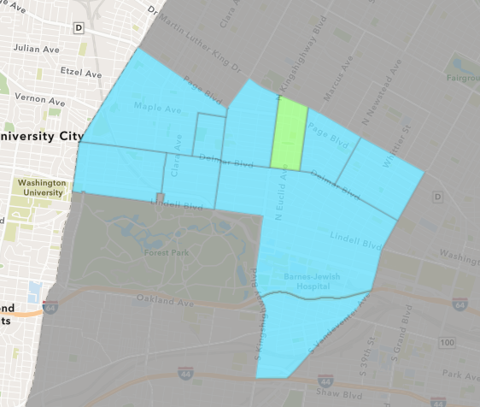
Fountain Park
February 2021 Neighborhood Cost Breakdown
Mean: $1,182,449
Median: $710,000
Range: $30,000 - $2,807,348

Slide 47
Fountain Park: Summary Notes
3 building permits in February 2021
Infinite change compared to February 2020 (0 total building permits)
$1,182,449: Average building permit cost in February 2021
Infinite change compared to February 2020 ($0)
3 total building permits in 2021
Infinite change YTD compared to this time in 2020 (0 total building permits)
$1,182,449: YTD average building permit cost in 2021
Infinite change YTD compared to this time in 2020 ($0)

Slide 48
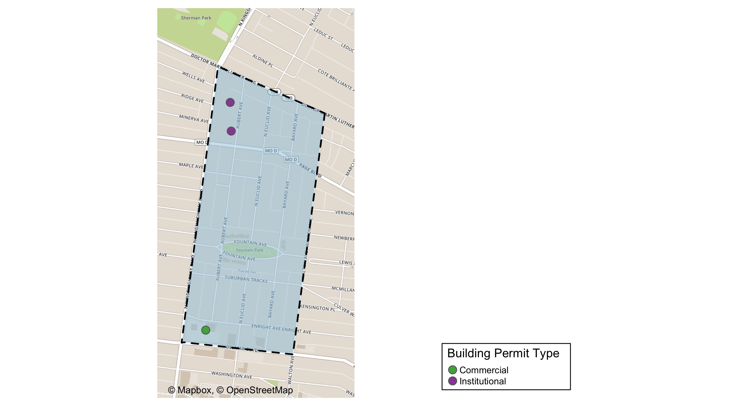
Fountain Park

Slide 49
Neighborhood Summary
February 2021 | February 2021 | February 2021 | February 2021
Permit Use | Average Cost | # of Permits | Total Value of Permits
Commercial | $710,000 | 1 | $710,000
Industrial | $0 | 0 | $0
Institutional | $1,418,674 | 2 | $2,837,348
Residential | $0 | 0 | $0
Last 6 Months | Last 6 Months | Last 6 Months | Last 6 Months
Permit Use | Average Cost | # of Permits | Total Value of Permits
Commercial | $370,000 | 2 | $740,000
Industrial | $0 | 0 | $0
Institutional | $1,418,674 | 2 | $2,837,348
Residential | $175,000 | 1 | $175,000

Slide 50
Fountain Park Individual Permit Breakdown
Owner | New Use | Cost | address
ROBERTS PLAZA LLC | Institutional | $2,807,348 | 1315 AUBERT AV
ALDI INC | Commercial | $710,000 | 702 N KINGSHIGHWAY BLVD
URBAN LEAGUE OF METROPOLITAM ST LOUI | Institutional | $30,000 | 1408 N KINGSHIGHWAY BLVD

Slide 51
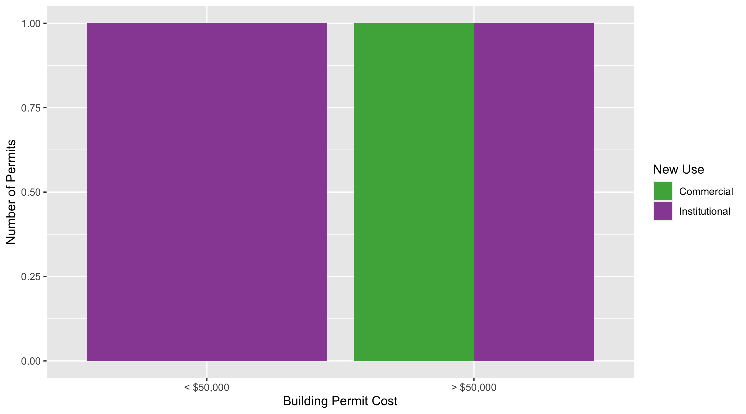
Fountain Park Permit Cost Breakdown

Slide 52
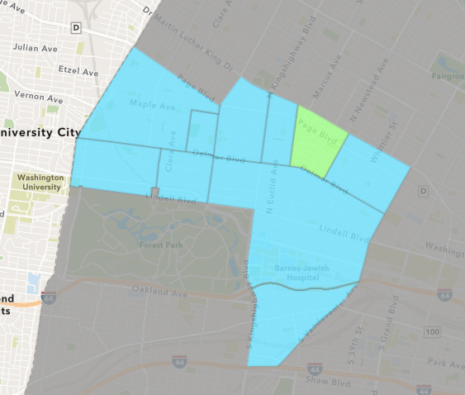
Lewis Place
February 2021 Neighborhood Cost Breakdown
Mean: $27,500
Median: $27,500
Range: $10,000 - $45,000

Slide 53
Lewis Place: Summary Notes
2 building permits in February 2021
Infinite change compared to February 2020 (0 total building permits)
$27,500: Average building permit cost in February 2021
Infinite change compared to February 2020 ($0)
4 total building permits in 2021
300.00% change YTD compared to this time in 2020 (1 total building permits)
$17,400: YTD average building permit cost in 2021
596.00% change YTD compared to this time in 2020 ($2,500)

Slide 54
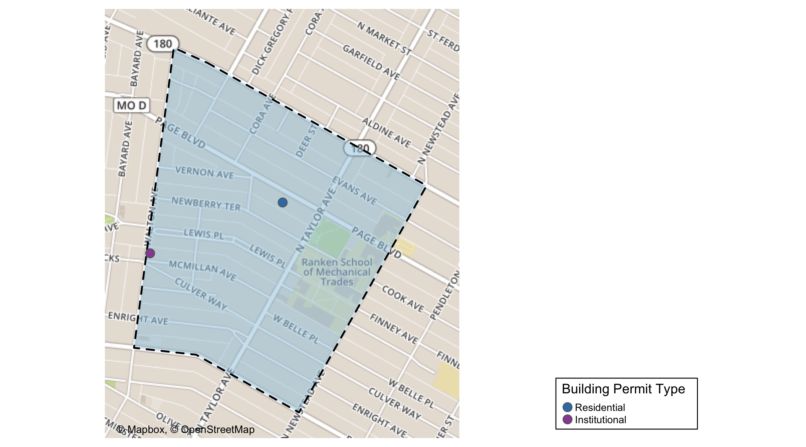
Lewis Place

Slide 55
Neighborhood Summary
February 2021 | February 2021 | February 2021 | February 2021
Permit Use | Average Cost | # of Permits | Total Value of Permits
Commercial | $0 | 0 | $0
Industrial | $0 | 0 | $0
Institutional | $10,000 | 1 | $10,000
Residential | $45,000 | 1 | $45,000
Last 6 Months | Last 6 Months | Last 6 Months | Last 6 Months
Permit Use | Average Cost | # of Permits | Total Value of Permits
Commercial | $6,000 | 1 | $6,000
Industrial | $0 | 0 | $0
Institutional | $10,000 | 2 | $20,000
Residential | $23,597 | 11 | $259,563

Slide 56
Lewis Place Individual Permit Breakdown
Owner | New Use | Cost | address
TURNBULL, JEANETTE | Residential | $45,000 | 4542 PAGE BLVD
LRA | Institutional | $10,000 | 4755 MCMILLAN AV

Slide 57
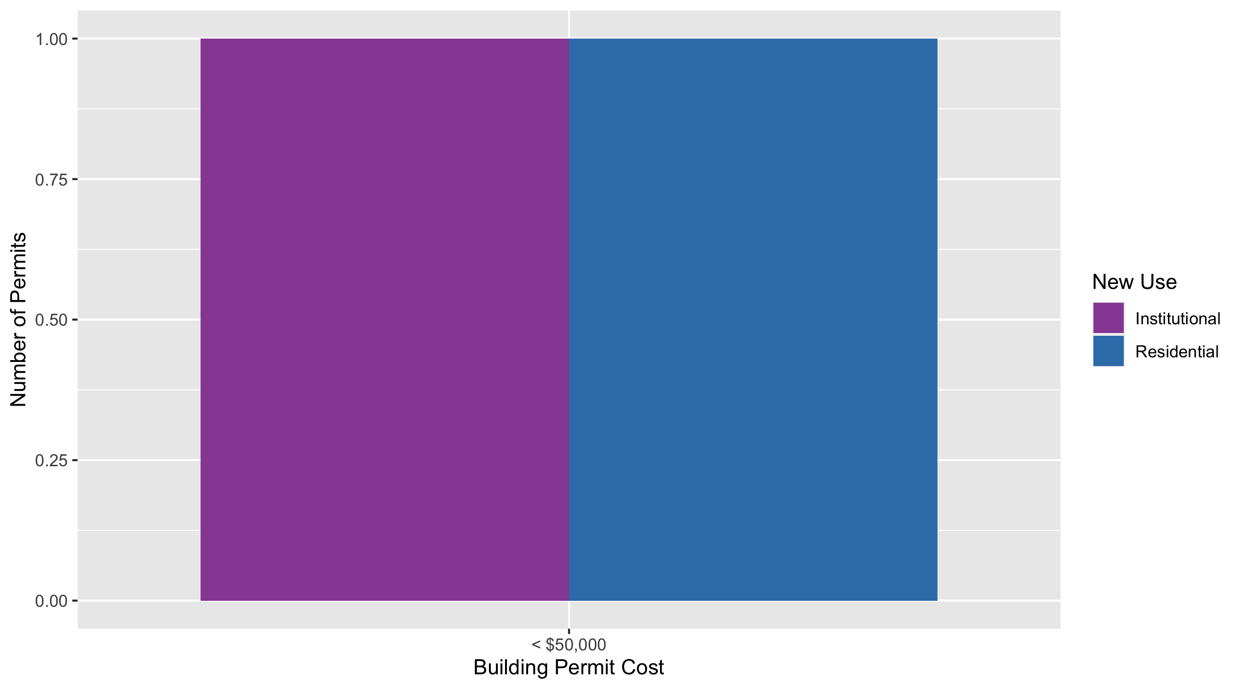
Lewis Place Permit Cost Breakdown

Slide 58
Additional Notes
Data retreived from https://www.stlouis-mo.gov/data/
Building permits with a cost of $0 were dropped
Building permits that were cancelled were dropped
Infinite change indicates 0 permits in the current or previous time period/comparison month so there was a overall increase or decrease

